Slide 1
What is TPRS?
This Photo by Unknown Author is licensed under CC BY-ND

Slide 2
This school year we will using TPRS! TPRS stands for Teaching Proficiency through Reading and Storytelling. It involves activities designed to introduce and strengthen your understanding of high frequency words and phrases in Spanish. The goal is to get each of you speaking Spanish!
This Photo by Unknown Author is licensed under CC BY-SA-NC

Slide 3
What does a TPRS class look like?
Storytelling
Story writing
Reading
Songs
Games
Video viewing

Slide 4
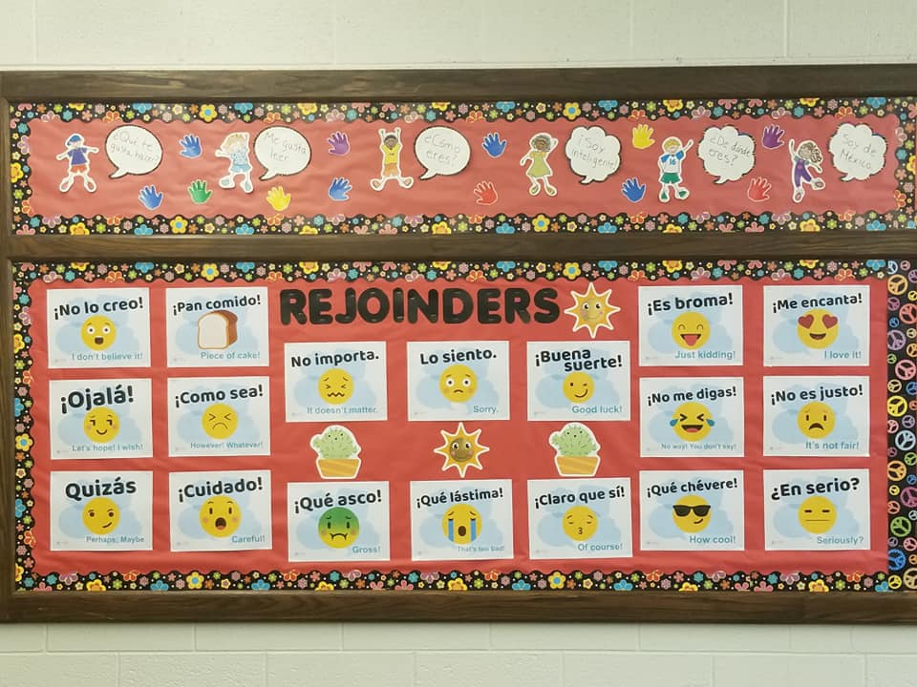
What are rejoinders?
Rejoinders are idiomatic or Native expressions that are used to react, interject, or to keep a conversation going.
Señora Peace encourages you to use rejoinders in class during our storytelling process and everyday conversations!

Slide 5
Why do you ask so many questions?
Since a main element of TPRS is asking numerous questions, Señora Peace will be frequently using the question posters in the classroom to check for understanding of our stories.
Señora Peace wants you to use the question posters when you have a question or need clarification.

Slide 6
How are students graded?
Each 25% of overall grade
Tests – Summative assessments given at the end of a chapter.
Quizzes – Short assessments given frequently to check understanding.
Paperwork & Homework – May take the form of translation, answering questions, illustrations, flash cards, or story writing.
Participation – Most important factor to success! Pay attention and come to class prepared to be an active participant

Slide 7
What materials do I need?
Pencil
Red checking pen
3 X 5 notecards
Lined paper or Spanish notebook
Folder for ONLY Spanish materials

Slide 8
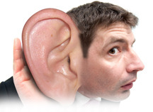
Rules for Staying in the Target Language
Remember the acronym L.I.S.T.E.N.
Look at me
Involve yourself
Show me you get it or don’t
Tune back in
Everything in the target language
No talking over me
This Photo by Unknown Author is licensed under CC BY-SA

Slide 9
Other General Classroom Rules
1.) Come to class with a POSITIVE attitude, PREPARED to learn.
2.) Keep your hands, feet, and objects to yourself.
3.) Raise your hand and wait to be called upon before speaking.
4.) Keep your voice to an inside working level.
5.) Stay on task without disturbing or distracting others.
6.) Always put forth your best effort.
7.) Keep your desk and classroom clean.
8.) Be POLITE, PLEASANT, and RESPECTFUL at all times.
This Photo by Unknown Author is licensed under CC BY-NC-ND

Slide 10
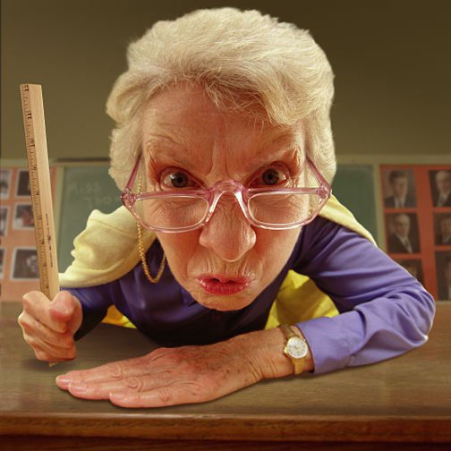
Consequences
Warning 1
Warning 2
Reflection form with parent signature
Office referral and parent contact
This Photo by Unknown Author is licensed under CC BY-NC-ND

Slide 11
Reference
TPRS information retrieved from https://tprsbooks.com
This Photo by Unknown Author is licensed under CC BY

