Slide 1
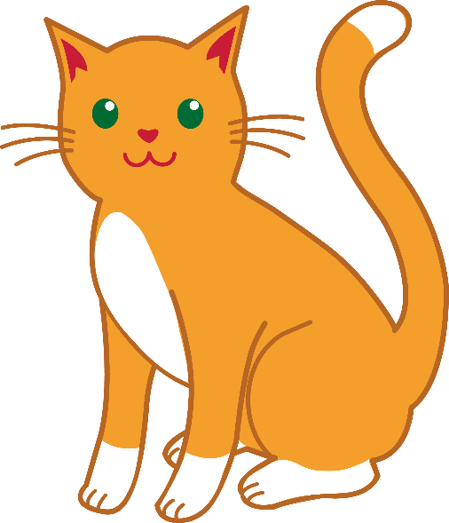
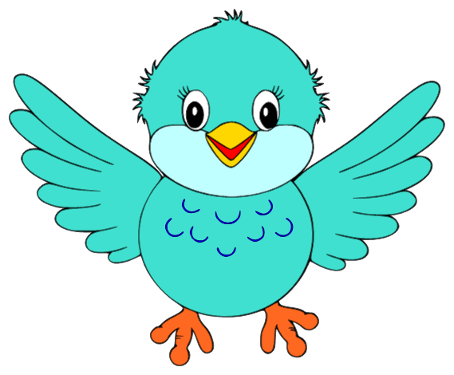
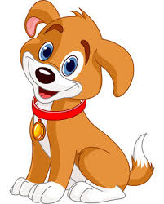
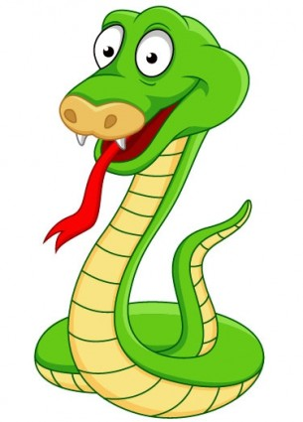
Los animales
gato
pájaro
perro
pez
pato
culebra

Slide 2
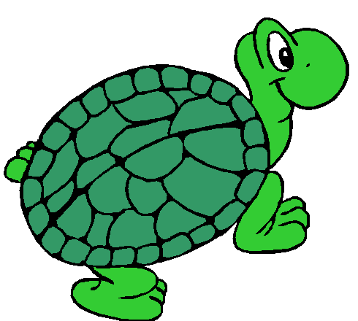
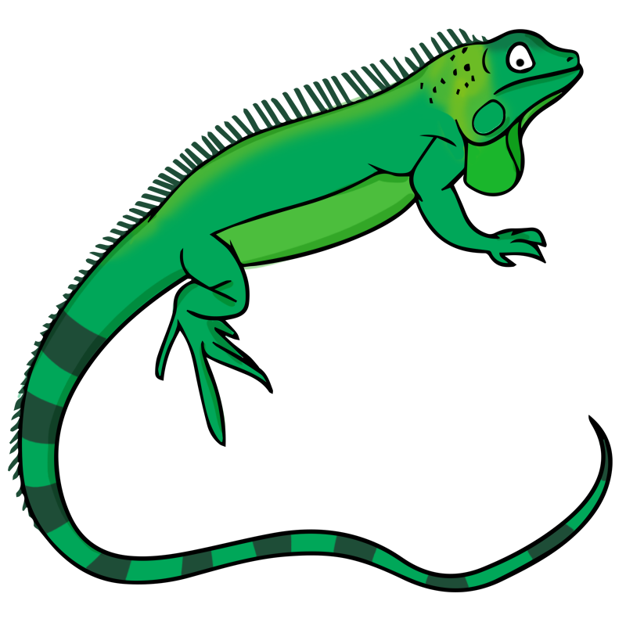
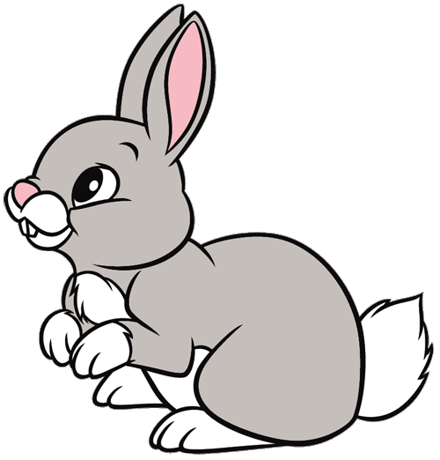
tortuga
iguana
conejo

Slide 3
Animal Song
(To the tune of “This Old Man”)
Gato – cat,
Perro – dog,
Pájaro is a flying bird.
Pez is a fish,
And pato is a duck,
Culebra is a slinky snake.

