Slide 1
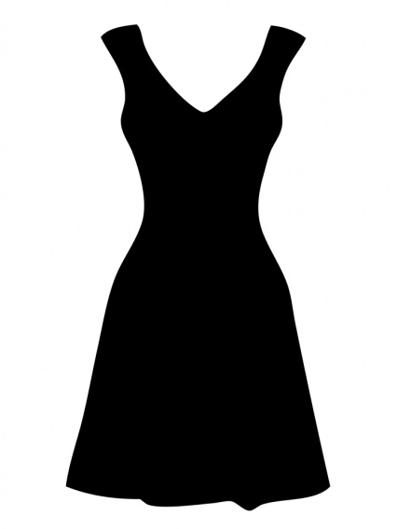
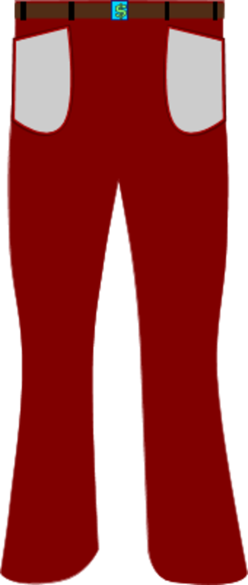
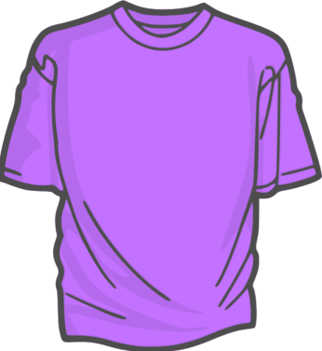
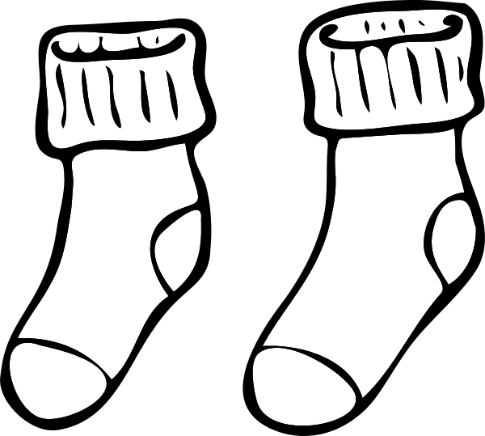
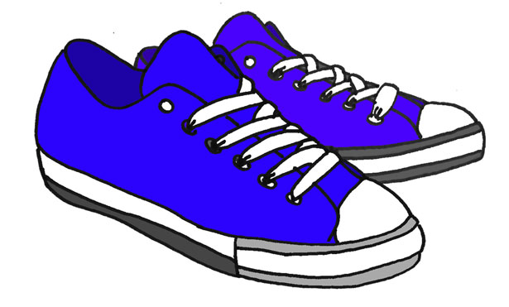
La ropa
camisa
vestido
pantalones
gorra
calcetines
zapatos

Slide 2
Clothing Song
Camisa – shirt,
Pantalones – pants,
Vestido – dress,
Calcetines – socks,
Zapatos – shoes,
Gorra – Cap,
These are the clothes that we wear.

