Slide 1
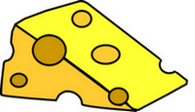
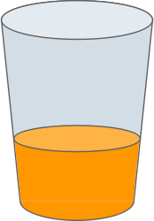
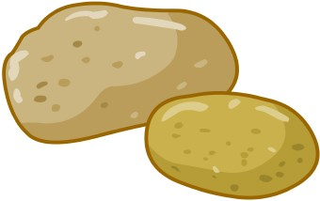
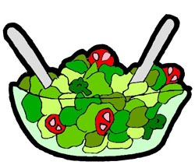
Food Vocabulary, Part 1
queso
leche
papa
jugo
pan
pollo
ensalada

Slide 2
Food Song
Queso is cheese, yum, yum, yum. (clap, clap)
Leche is milk, yum, yum, yum. (clap, clap)
Papa is potato.
Jugo is juice.
Pan is bread, yum, yum, yum! (clap, clap)
Pollo is chicken, yum, yum, yum. (clap, clap)
Ensalada is salad, yum, yum, yum. (clap, clap)
Queso, leche, papa,
jugo, pan, pollo, ensalada,
yum, yum, yum, yum, yum! (clap, clap)

Slide 3
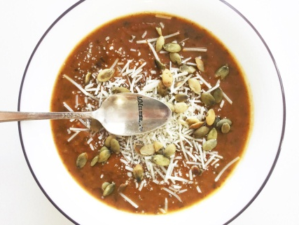
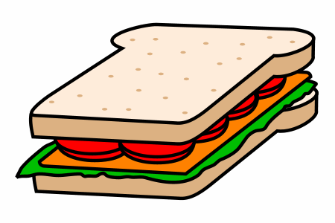
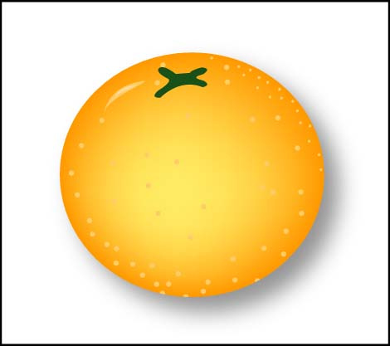
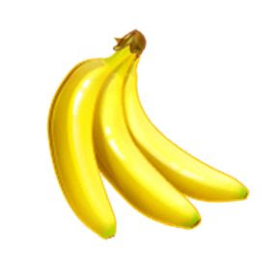
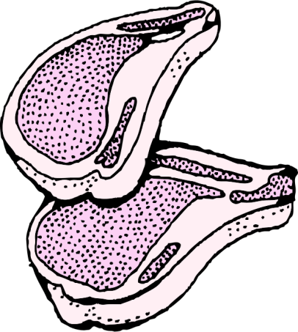
Food Vocabulary, Part 2
manzana
sandwich
sopa
agua
carne
naranja
plátano

Slide 4
Food Song
Manzana is an apple, yum, yum, yum. (clap, clap)
Sandwich is sandwich, yum, yum, yum. (clap, clap)
Sopa is soup.
Agua is water.
Carne is meat, yum, yum, yum! (clap, clap)
Naranja is an orange, yum, yum, yum. (clap, clap)
Plátano is a banana, yum, yum, yum. (clap, clap)
Manzana, sandwich, sopa,
agua, carne, naranja, plátano,
yum, yum, yum, yum, yum! (clap, clap)

