Slide 1
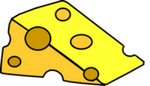
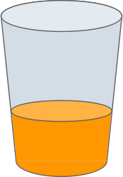
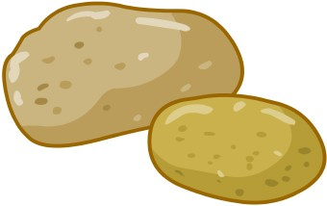
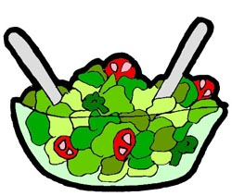
Food & Drink Vocabulary
queso
leche
papa
jugo
pan
pollo
ensalada

Slide 2
Food Song
Queso is cheese, yum, yum, yum. (clap, clap)
Leche is milk, yum, yum, yum. (clap, clap)
Papa is potato.
Jugo is juice.
Pan is bread, yum, yum, yum! (clap, clap)
Pollo is chicken, yum, yum, yum. (clap, clap)
Ensalada is salad, yum, yum, yum. (clap, clap)
Queso, leche, papa,
jugo, pan, pollo, ensalada,
yum, yum, yum, yum, yum! (clap, clap)

